Slide 1
Tutorial 3 – Android Basic Navigation
Mobile Computing and Application Development
This note is partly based on the Google Developers Training - Android Developer Fundamentals V2 Slides share under CC Attribution
This work is licensed under a Creative Commons Attribution 4.0 International License.

Slide 2
Contents
Activities
Defining an Activity
Starting a new Activity with an Intent
Passing data between activities with extras
Navigating between activities

Slide 3
Activities
(high-level view)

Slide 4
What is an Activity?
An Activity is an application component
Represents one window, one hierarchy of views
Typically fills the screen, but can be embedded in other Activity or a appear as floating window
Java class, typically one Activity in one file
Notes:
an Activity represents a single screen in your app in which your user can perform a single, focused task.

Slide 5
What does an Activity do?
Represents an activity, such as ordering groceries, sending email, or getting directions
Handles user interactions, such as button clicks, text entry, or login verification
Can start other activities in the same or other apps
Has a life cycle—is created, started, runs, is paused, resumed, stopped, and destroyed

Slide 6
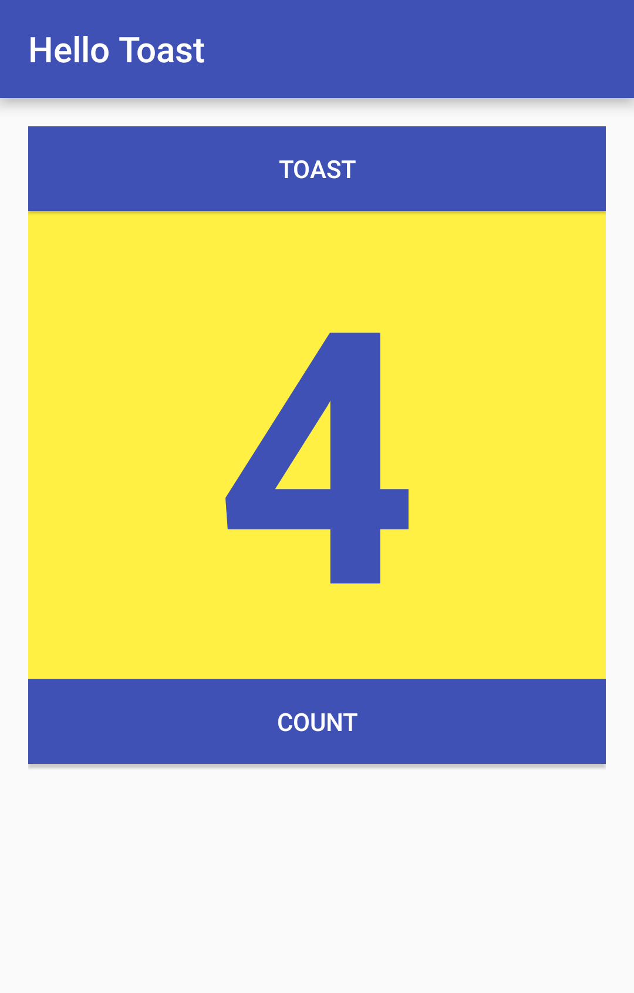
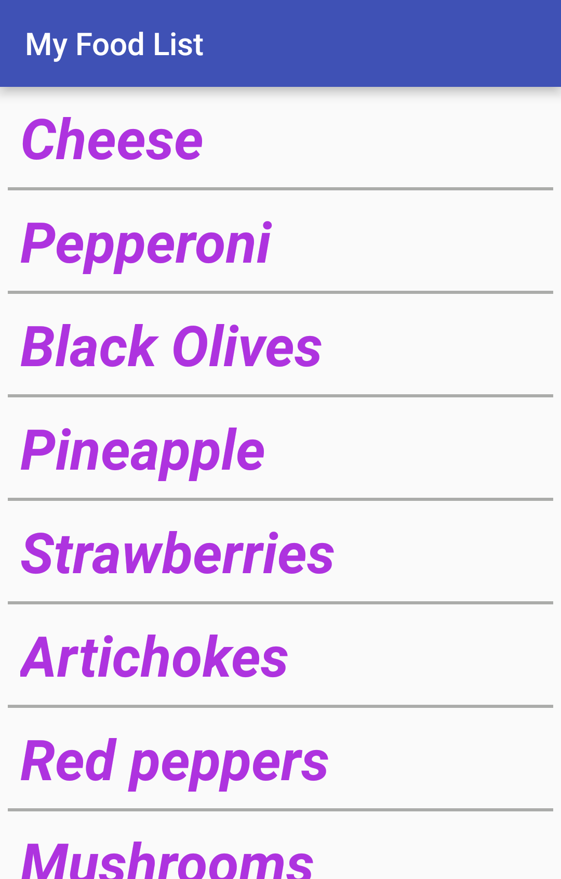
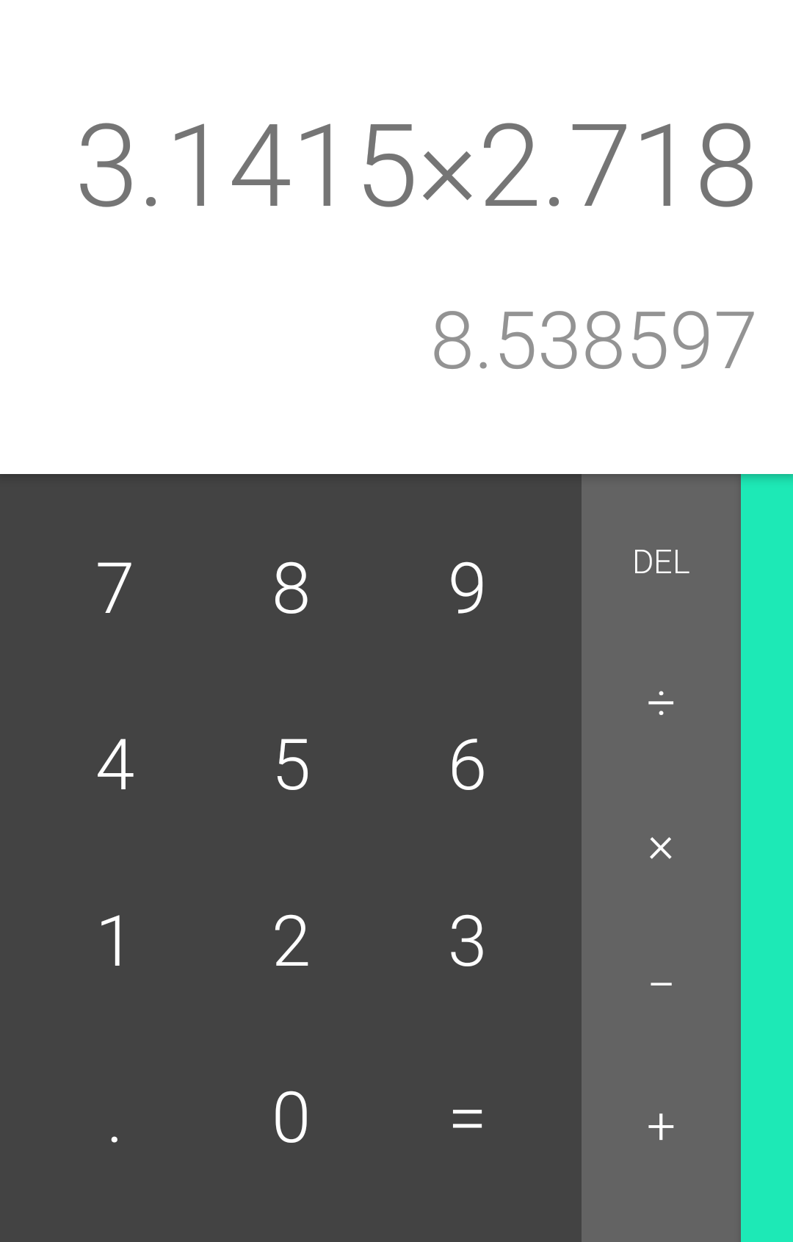
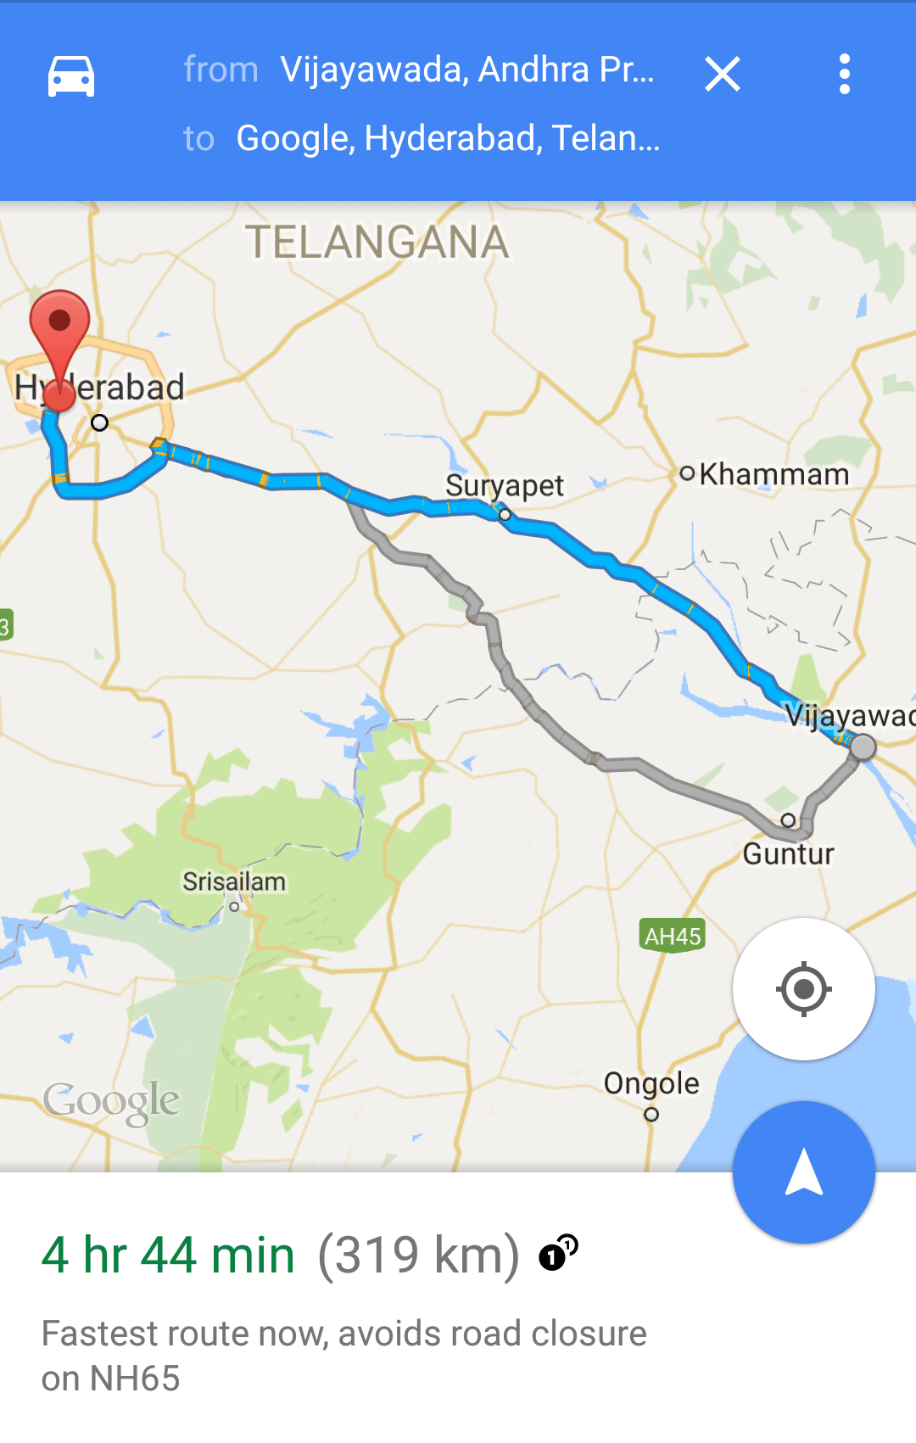
Examples of activities

Slide 7
Apps and activities
Activities are loosely tied together to make up an app
First Activity user sees is typically called "main activity"
Activities can be organized in parent-child relationships in the Android manifest to aid navigation

Slide 8
Layouts and Activities
An Activity typically has a UI layout
Layout is usually defined in one or more XML files
Activity "inflates" layout as part of being created

Slide 9
Implementing Activities

Slide 10
Implement new activities
Define layout in XML
Define Activity Java class
extends AppCompatActivity
Connect Activity with Layout
Set content view in onCreate()
Declare Activity in the Android manifest

Slide 11
Define layout in XML
<?xml version="1.0" encoding="utf-8"?>
<RelativeLayout
xmlns:android="http://schemas.android.com/apk/res/android"
android:layout_width="match_parent"
android:layout_height="match_parent">
<TextView
android:layout_width="wrap_content"
android:layout_height="wrap_content"
android:text="Let's Shop for Food!" />
</RelativeLayout>

Slide 12
2. Define Activity Java class
public class MainActivity extends AppCompatActivity {
@Override
protected void onCreate(Bundle savedInstanceState) {
super.onCreate(savedInstanceState);
}
}

Slide 13
3. Connect activity with layout
public class MainActivity extends AppCompatActivity {
@Override
protected void onCreate(Bundle savedInstanceState) {
super.onCreate(savedInstanceState);
setContentView(R.layout.activity_main);
}
}
Resource
is layout
in this XML file
Notes:
In Android R is an Java-class that is auto-generated from your resources by the build process.

Slide 14
4. Declare activity in Android manifest
<activity android:name=".MainActivity">
Notes:
here the point means the MainActivity Class is right inside the package. for example, our mainactivty class is inside .edu.cuhk.xxx. package.

Slide 15
4. Declare main activity in manifest
MainActivity needs to include intent-filter to start from launcher
<activity android:name=".MainActivity">
<intent-filter>
<action android:name="android.intent.action.MAIN" />
<category android:name="android.intent.category.LAUNCHER" />
</intent-filter>
</activity>
Notes:
it allows the android system start the mainactivaty from the laucher.

Slide 16
Intents

Slide 17
What is an intent?
An Intent is a description of an operation to be performed.
An Intent is an object used to request an action from another app component via the Android system.
Originator
App component
Intent
Action
Android System

Slide 18
What can intents do?
Start an Activity
A button click starts a new Activity for text entry
Clicking Share opens an app that allows you to post a photo
Start an Service
Initiate downloading a file in the background
Deliver Broadcast
The system informs everybody that the phone is now charging

Slide 19
Explicit and implicit intents
Explicit Intent
Starts a specific Activity
Request tea with milk delivered by Nikita
Main activity starts the ViewShoppingCart Activity
Implicit Intent
Asks system to find an Activity that can handle this request
Find an open store that sells green tea
Clicking Share opens a chooser with a list of apps
Notes:
Implicit intent means that it lets the system to handle the request. For example, open a app chooser with a list of app. Or it finds the outside or external activity in other app to handle the request.

Slide 20
Starting Activities

Slide 21
Start an Activity with an explicit intent
To start a specific Activity, use an explicit Intent
Create an Intent
Intent intent = new Intent(this, ActivityName.class);
Use the Intent to start the Activity
startActivity(intent);

Slide 22
Start an Activity with implicit intent
To ask Android to find an Activity to handle your request, use an implicit Intent
Create an Intent
Intent intent = new Intent(action, uri); // Universal Resource Identifier
Use the Intent to start the Activity
startActivity(intent);
Notes:
uri Universal Resource Identifier

Slide 23
Implicit Intents - Examples
Show a web page Uri uri = Uri.parse("http://www.google.com"); Intent it = new Intent(Intent.ACTION_VIEW,uri); startActivity(it);
Dial a phone number Uri uri = Uri.parse("tel:8005551234");
Intent it = new Intent(Intent.ACTION_DIAL, uri);
startActivity(it);

Slide 24
How Activities Run
All Activity instances are managed by the Android runtime
Started by an "Intent", a message to the Android runtime to run an activity
User clicks launcher icon
MainActivity What do you want to do?
FoodListActivity Choose food items...Next
OrderActivity Place order
Intent: Start app
Start main activity
Intent: Shop
Start choose food activity
Intent: order
Start finish order activity
Android System
Android System
Android System

Slide 25
Sending and Receiving Data

Slide 26
Two types of sending data with intents
Data—one piece of information whose data location can be represented by an URI
Extras—one or more pieces of information as a collection of key-value pairs in a Bundle

Slide 27
Sending and retrieving data
In the first (sending) Activity:
Create the Intent object
Put data or extras into that Intent
Start the new Activity with startActivity()
In the second (receiving) Activity:
Get the Intent object, the Activity was started with
Retrieve the data or extras from the Intent object

Slide 28
Putting a URI as intent data
// A web page URL
intent.setData(
Uri.parse("http://www.google.com"));
// a Sample file URI
intent.setData(
Uri.fromFile(new File("/sdcard/sample.jpg")));

Slide 29
Put information into intent extras
Option 1
putExtra(String name, int value) intent.putExtra("level", 406);
putExtra(String name, String[] value) String[] foodList = {"Rice", "Beans", "Fruit"}; intent.putExtra("food", foodList);
putExtras(bundle); ⇒ if lots of data, first create a bundle and pass the bundle.
See documentation for all
Option 2
Option 3

Slide 30
Sending data to an activity with extras
public static final String EXTRA_MESSAGE_KEY = "edu.cuhk.csci3310.cueat.extra.MESSAGE";
Intent intent = new Intent(this, SecondActivity.class);
String message = "Hello Activity!";
intent.putExtra(EXTRA_MESSAGE_KEY, message);
startActivity(intent);

Slide 31
Get data from intents
Intent intent = getIntent();
getData(); Uri locationUri = intent.getData();
int getIntExtra (String name, int defaultValue) int level = intent.getIntExtra("level", 0);
Bundle bundle = intent.getExtras(); ⇒ Get all the data at once as a bundle.
See documentation for all
Option 1
Option 2
Option 3

Slide 32
Returning data to the starting activity
Use startActivityForResult() to start the second Activity
To return data from the second Activity:
Create a new Intent
Put the response data in the Intent using putExtra()
Set the result to Activity.RESULT_OK or RESULT_CANCELED, if the user cancelled out
call finish() to close the Activity
Implement onActivityResult() in first Activity

Slide 33
startActivityForResult()
startActivityForResult(intent, requestCode);
Starts Activity (intent), assigns it identifier (requestCode)
Returns data via Intent extras
When done, pop stack, return to previous Activity, and execute onActivityResult() callback to process returned data
Use requestCode to identify which Activity has "returned"

Slide 34
startActivityForResult() Example
public static final int CHOOSE_FOOD_REQUEST = 1;
Intent intent = new Intent(this, DetailedViewActivity.class);
startActivityForResult(intent, CHOOSE_FOOD_REQUEST);

Slide 35
Return data and finish second activity
// Create an intent
Intent replyIntent = new Intent();
// Put the data to return into the extra
replyIntent.putExtra(EXTRA_REPLY, reply);
// Set the activity's result to RESULT_OK
setResult(RESULT_OK, replyIntent);
// Finish the current activity
finish();

Slide 36
Implement onActivityResult()
public void onActivityResult(int requestCode,
int resultCode, Intent data) {
super.onActivityResult(requestCode, resultCode, data);
if (requestCode == TEXT_REQUEST) { // Identify activity
if (resultCode == RESULT_OK) { // Activity succeeded
String reply = data.getStringExtra(SecondActivity.EXTRA_REPLY);
// … do something with the data
}}}

Slide 37
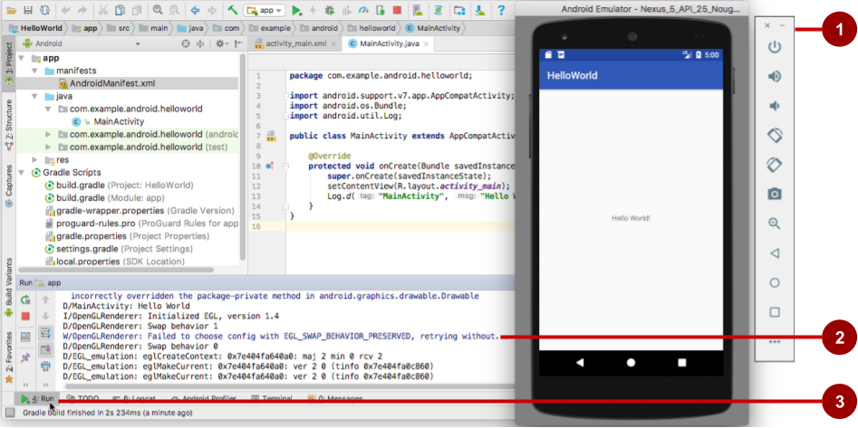
Get feedback as your app runs
Emulator running the app
Run pane
Run tab to open or close the Run pane

Slide 38
Adding logging to your app
As the app runs, the Logcat pane shows information
Add logging statements to your app that will show up in the Logcat pane
Set filters in Logcat pane to see what's important to you
Search using tags

Slide 39
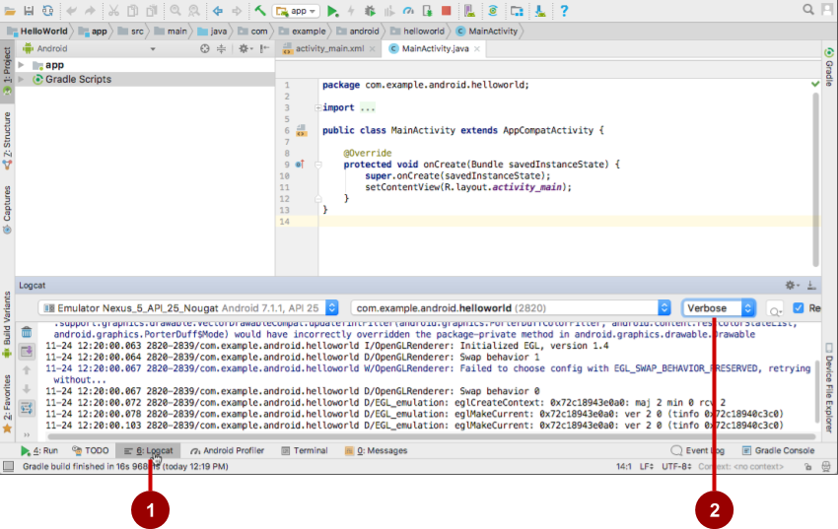
The Logcat pane
Logcat tab to show Logcat pane
Log level menu

Slide 40
Logging statement
import android.util.Log;
// Use class name as tag
private static final String TAG = MainActivity.class.getSimpleName();
// Show message in Android Monitor, logcat pane
// Log.<log-level>(TAG, "Message");
Log.d(TAG, “Creating the URI…”);

